Slide 1

Unit testing
In Java
Hany Ahmed
i@namozag.com
Unit testing, Maven, JUnit, AssertJ, Mockito

Slide 2
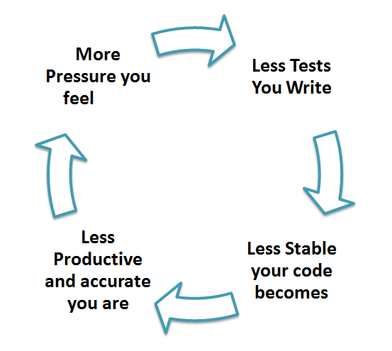
Motivation

Slide 3
Normal application structure
Modules
Integrations
Resources
UI
External system
Logic
Storage
Notes:
https://en.wikipedia.org/wiki/Software_testing
http://www.tutorialspoint.com/software_testing/software_testing_levels.htm

Slide 4
System
Application C
Application A
Module 1
Module 2
What should be tested?
functions
functions
Application B
Module 3
Module 4
functions
functions
Storage

Slide 5
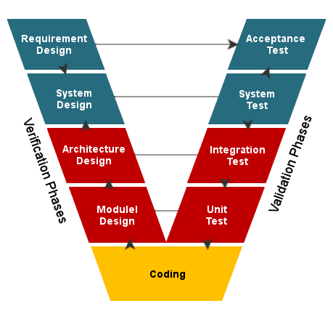
Testing levels
Notes:
Requirement Analysis: This phase contains detailed communication with the customer to understand their requirements and expectations. This stage is known as Requirement Gathering.
System Design: This phase contains the system design and the complete hardware and communication setup for developing product.
Architectural Design: System design is broken down further into modules taking up different functionalities. The data transfer and communication between the internal modules and with the outside world (other systems) is clearly understood.
Module Design: In this phase the system breaks down into small modules. The detailed design of modules is specified, also known as Low-Level Design (LLD).
—-------------------
Unit Testing A level of the software testing process where individual units/components of a software/system are tested. The purpose is to validate that each unit of the software performs as designed.
Integration Testing A level of the software testing process where individual units are combined and tested as a group. The purpose of this level of testing is to expose faults in the interaction between integrated units.
System Testing A level of the software testing process where a complete, integrated system/software is tested. The purpose of this test is to evaluate the system’s compliance with the specified requirements.
Acceptance Testing A level of the software testing process where a system is tested for acceptability. The purpose of this test is to evaluate the system’s compliance with the business requirements and assess whether it is acceptable for delivery.
https://www.geeksforgeeks.org/software-engineering-sdlc-v-model/
http://softwaretestingfundamentals.com/software-testing-levels/

Slide 6
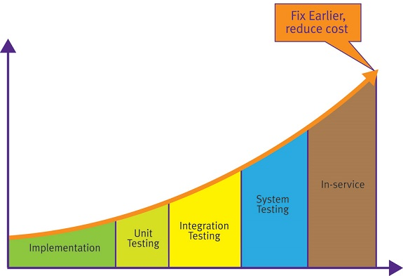
Issues fixing cost

Slide 7
Unit test

Slide 8

Scope
Test a small piece of code (usually a function) independently from other parts

Slide 9
Test steps
BDD AAA
Preconditions Given Arrange
Action When Act
Assertions Then Assert

Slide 10
Test coverage
Decision
Decision
if ( condition || condition ) {
line;
line;
} else {
line;
}
line;
if ( condition ) {
line;
line;
line;
}
line;
line;
Branch
on decision true
Branch
on decision true
Branch (hidden)
on decision false
Branch
on decision false

Slide 11

F.I.R.S.T
Fast
Isolated/Independent
Repeatable
Self-validating
Thorough
Notes:
Fast
A developer should not hesitate to run the tests as they are slow.
All of these including setup, the actual test and tear down should execute really fast (milliseconds) as you may have thousands of tests in your entire project.
Isolated/Independent
A test method should do the 3 As => Arrange, Act, Assert
Arrange: The data used in a test should not depend on the environment in which the test is running. All the data needed for a test should be arranged as part of the test.
Act: Invoke the actual method under test.
Assert: A test method should test for a single logical outcome, implying that typically there
should be only a single logical assert. A logical assert could have multiple physical asserts as
long as all the asserts test the state of a single object. In a few cases, an action can update
multiple objects.
Avoid doing asserts in the Arrange part, let it throw exceptions and your test will still fail.
No order-of-run dependency. They should pass or fail the same way in suite or when run individually.
Do not do any more actions after the assert statement(s), preferably single logical assert.
Repeatable
A test method should NOT depend on any data in the environment/instance in which it is running.
Deterministic results - should yield the same results every time and at every location where they run.
No dependency on date/time or random functions output.
Each test should setup or arrange it's own data.
What if a set of tests need some common data? Use Data Helper classes that can setup this data for re-usability.
Self-Validating
No manual inspection required to check whether the test has passed or failed.
Thorough and Timely
Should cover every use case scenario and NOT just aim for 100% coverage.
Should try to aim for Test Driven Development (TDD) so that code does not need re-factoring later.
https://github.com/ghsukumar/SFDC_Best_Practices/wiki/F.I.R.S.T-Principles-of-Unit-Testing

Slide 12


Unit testing challenges
Dependencies
Long complex methods
new keyword
100% Coverage
Depend on interfaces
SRP, refactoring
Dependency Injection

Slide 13

Not to test
“Don’t test already tested things”
Trivial code
Getters & Setters
Database
Frameworks/libraries (well-tested)

Slide 14
Project structure
----------
Maven

Slide 15

What’s ?
Uniform build system
Simple project setup
Dependency management
Extensible (plugins)
Easy to work with multiple projects/modules
Start with ready made templates (archtypes)
Maintain project quality (run tests)
Supports multiple profiles

Slide 16
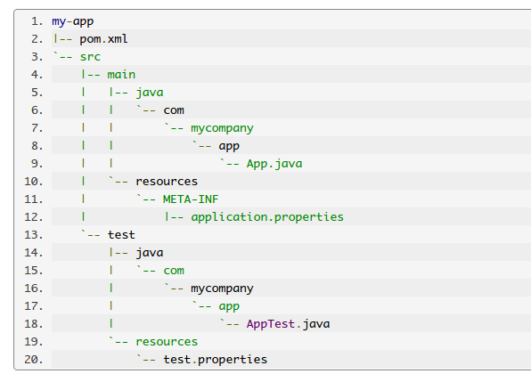
Maven Directory structure
App
pom.xml
src
main
java
Resources
test
java
resources

Slide 17
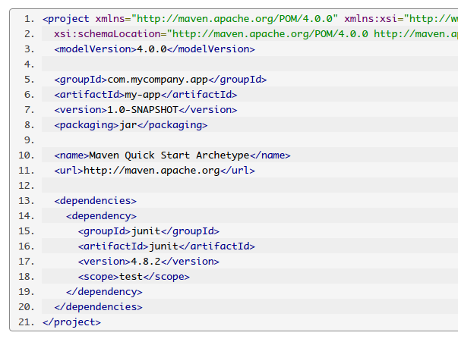
Maven POM
artifact
packaging
jar
war
pom
version
SNAPSHOT
RELEASE
dependencies

Slide 18
Maven Dependencies
Repository
Local [cache] (~/.m2/repository)
Remote
Internal (Hosted on company)
Remote (Hosted globally)
Central (http://repo.maven.apache.org/maven2/)
Scope
compile
test
provided

Slide 19
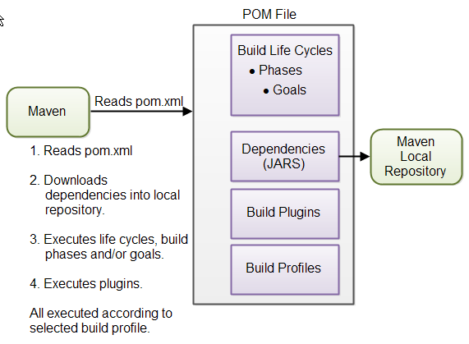
Maven Build

Slide 20
Maven lifecycle
Validate pom.xml
generate-resources resources (src/main/resources)
process-resources resources (src/main/resources)
compile sources (src/main/java) → class
test-compile test sources (src/test/java) → class
test surefire plugin (Unit testing)
package jar/war/…
verify failsafe plugin (Integration testing)
install → Local repository
deploy → Remote repository
Notes:
validate - validate the project is correct and all necessary information is available
compile - compile the source code of the project
test - test the compiled source code using a suitable unit testing framework. These tests should not require the code be packaged or deployed
package - take the compiled code and package it in its distributable format, such as a JAR.
verify - run any checks on results of integration tests to ensure quality criteria are met
install - install the package into the local repository, for use as a dependency in other projects locally
deploy - done in the build environment, copies the final package to the remote repository for sharing with other developers and projects.

Slide 21
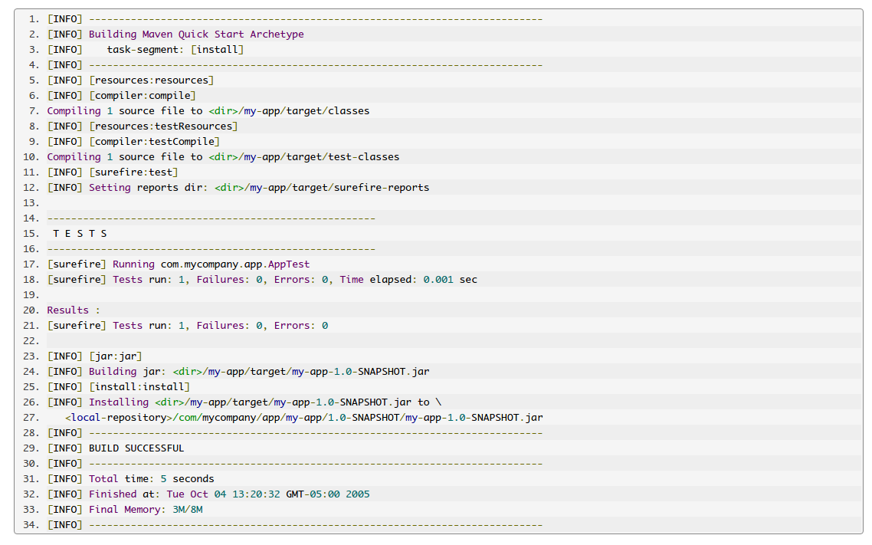
Mvn install
Applying Unit testing on
**/*Test.java
**/Test*.java
**/*TestCase.java

Slide 22
Test runner
----------
JUnit
Notes:
http://www.vogella.com/tutorials/JUnit/article.html

Slide 23
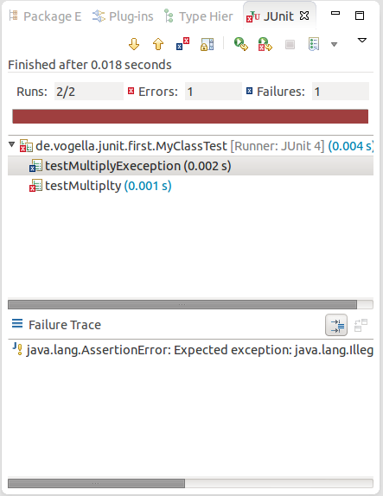
Unit testing
Unit testing scope
Test cases
Execution order
Predictability

Slide 24

JUnit
Test method
@org.junit.jupiter.api.Test
Test class
*Test
Test Suite

Slide 25

Test lifecycle
@BeforeAll @BeforeClass
@BeforeEach @Before
@Test
@AfterEach @After
@AfterAll @AfterClass

Slide 26
Naming convention
Feature
registerAddsUser
throwsExceptionWhenRegisterUser/IfMailIsInvalid
failToWithdrawMoney/IfAccountIsInvalid
Should
userShouldBeCreated
userShouldNotBeCreated/IfMailIsInvalid
moneyShouldNotBeWithdrawn/IfAccountIsInvalid
BDD
givenValidUser_whenRegister_thenSucceed
givenUserWithInvalidMail_whenRegister_thenThrowException
givenAnInvalidAccount_whenWithdraw_thenFail

Slide 27
JUnit assertions
fail(message)
assertTrue/assertFalse([message,] boolean condition)
assertEquals([message,] expected, actual)
assertNull/assertNotNull([message,] object)
assertSame/assertNotSame([message,] expected, actual)
Notes:
fail(message) Let the method fail. Might be used to check that a certain part of the code is not reached or to have a failing test before the test code is implemented. The message parameter is optional.
assertTrue([message,] boolean condition) Checks that the boolean condition is true.
assertFalse([message,] boolean condition) Checks that the boolean condition is false.
assertEquals([message,] expected, actual) Tests that two values are the same. Note: for arrays the reference is checked not the content of the arrays.
assertEquals([message,] expected, actual, tolerance) Test that float or double values match. The tolerance is the number of decimals which must be the same.
assertNull([message,] object) Checks that the object is null.
assertNotNull([message,] object) Checks that the object is not null.
assertSame([message,] expected, actual) Checks that both variables refer to the same object.
assertNotSame([message,] expected, actual) Checks that both variables refer to different objects.

Slide 28
Code coverage
----------
JaCoCo
Notes:
http://www.vogella.com/tutorials/JUnit/article.html

Slide 29
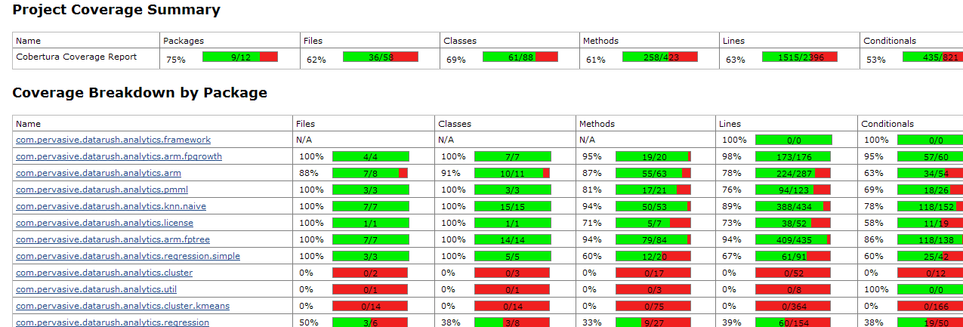
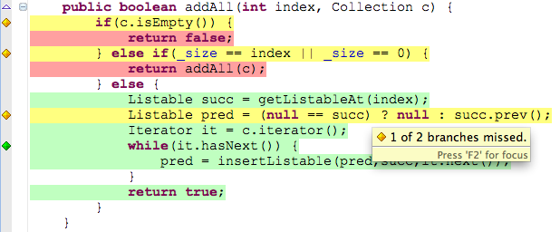
Code coverage

Slide 30
Fluent Assertions
----------
AssertJ
Notes:
http://joel-costigliola.github.io/assertj/

Slide 31
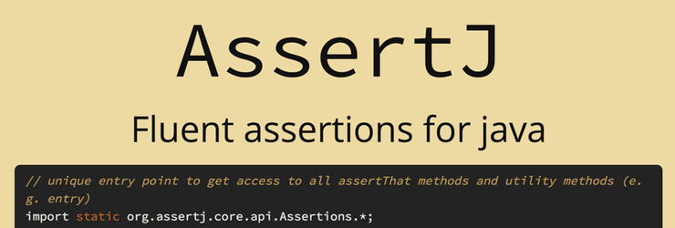
AssertJ
A Java library that provides a fluent interface for writing assertions.
Goal: improve test code Readability & Maintainability.
Notes:
http://joel-costigliola.github.io/assertj/assertj-core.html

Slide 32
First look
assertThat(frodo.getAge()).isEqualTo(100);
assertThat(frodo.getAge()).as("check %s's age", frodo.getName()).isEqualTo(100);
// Assertion error [check Frodo's age] expected:<33> but was:<100>

Slide 33
basic assertions
assertThat(frodo.getName()).isEqualTo("Frodo");
assertThat(frodo).isNotEqualTo(sauron) .isIn(fellowshipOfTheRing);
assertThat(frodo.getName()).startsWith("Fro") .endsWith("do") .isEqualToIgnoringCase("frodo");

Slide 34
Collection specific assertions
assertThat(fellowshipOfTheRing)
.hasSize(9)
.contains(frodo, sam)
.doesNotContain(sauron);

Slide 35
Exception Assertion
// Java 8 exception assertion assertThatThrownBy(() -> { throw new Exception("boom!"); }).isInstanceOf(Exception.class) .hasMessageContaining("boom"); // Java 8 BDD style exception assertion Throwable thrown = catchThrowable(() -> { throw new Exception("boom!"); }); assertThat(thrown).isInstanceOf(Exception.class) .hasMessageContaining("boom");

Slide 36
Extracting
assertThat(fellowshipOfTheRing).extracting("name") .contains("Boromir", "Gandalf", "Frodo") .doesNotContain("Sauron", "Elrond"); // Java 8 (type safe) assertThat(fellowshipOfTheRing).extracting(TolkienCharacter::getName) .contains("Boromir", "Gandalf", "Frodo") .doesNotContain("Sauron", "Elrond"); // multiple values at once (using a tuple) assertThat(fellowshipOfTheRing).extracting("name", "age", "race.name") .contains(tuple("Boromir", 37, "Man"), tuple("Sam", 38, "Hobbit"), tuple("Legolas", 1000, "Elf"));

Slide 37
Mocking
----------
Mockito
Notes:
http://mockito.org/

Slide 38

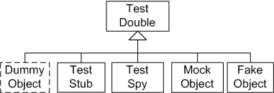
Test Doubles
Double is a generic term for any case where you replace a production object for testing purposes
Notes:
http://www.martinfowler.com/bliki/TestDouble.html

Slide 39
Ex.
Interface
Stub
Mock
Fake
Spy
Real
void cache(K, V)
int size()
void cache(K, V) {}
int size() { return 1 }
void cache(K, V) { calls++ }
int size() { return 1 }
int callTimes(){ return calls }
void cache(K, V) {map.put(..)}
int size() {return map.size()}
Map
void cache(K, V)
{ cs.store(..) ; calls++ }
int callTimes(){ return calls }
void cache(K, V) {cs.store(..)}
int size() { return cs.size() }
Cache
System

Slide 40
System layers/modules
UI
// Testing UI, Logic, …
Every layer should mock layer below → Mock
// Testing Data Access Layer
Mocking DB is a hard task
We can depend on a light DB (in-memory) → Fake
Logic
Data
DB

Slide 41

Mockito
A framework that enables you to easily generate test doubles for testing purpose
It allows you to verify execution and write logic inside your mocked objects

Slide 42
First look
// mock creation List list = mock(List.class); // using mock object list.add("one"); list.clear(); // selective, explicit, highly readable verification verify(list).add("one"); verify(list).clear();

Slide 43
Stub method calls
// you can mock concrete classes, not only interfaces LinkedList list = mock(LinkedList.class); // stubbing appears before the actual execution when(list.get(0)).thenReturn("first"); // prints "first" System.out.println(list.get(0)); // prints "null" because get(999) was not stubbed System.out.println(list.get(999));

Slide 44
Stubbing - throw exceptions
LinkedList list = mock(LinkedList.class); //stubbing when(list.get(1)).thenThrow(new RuntimeException());
//or
doThrow(new RuntimeException()).when(list).get(1); //following throws runtime exception System.out.println(list.get(1));

Slide 45
Verify
//using mocks - only mockOne is interacted mockOne.add("one"); //ordinary verification verify(mockOne).add("one"); //verify that method was never called on a mock verify(mockOne, never()).add("two"); //verify that other mocks were not interacted verifyZeroInteractions(mockTwo, mockThree);

Slide 46
Callbacks
when(mock.someMethod(anyString())).thenAnswer(new Answer() { Object answer(InvocationOnMock invocation) { Object[] args = invocation.getArguments(); Object mock = invocation.getMock(); return "called with arguments: " + args; } }); //the following prints "called with arguments: foo" System.out.println(mock.someMethod("foo"));

